Slide 1
JOHN HANCOCK Migration from SOA to MSA
Mar 29, 2018

Slide 2

Table of Contents
What is Microservice
Microservice & Cloud Native Arch Characteristics
Representative service
Design Challenges
Migration Strategy
Assumptions & Dependencies
Indicative Executive Plan
Commercials

Slide 3
What is Microservice ?
an architectural style to build a distributed system* where
a single application is broken into suite of small services,
use event driven mechanism for inter-service communication
support polyglot technologies & persistence stores
package, deploy & scale independently
built around bounded contexts** & exposed as API
* A distributed system is a software application in which components located on networked computers communicate and coordinate their actions by issuing calls or passing messages
** Bounded context is a conceptual boundary around business capability that is used in Domain Driven Design (DDD)

Slide 4
Microservices Principles
High Cohesion
Implement cohesive set of functionalities as service
Service manage its own data & logic separately
Loose Coupling
Independently changeable services
Independently deployable units
Smart endpoints and dumb pipes
No central orchestration, based on service choreography
Bounded Context
Represent a business function or business domain
Each domain has explicit interface to interact
Shared model is decoupled from internal implementation
Resilience
Design for failure at application level
Automated fail over & recoverability
Observable
Centrally monitoring application health
Log aggregation & visualization of disparate applications
Automation
Embrace DevOps’s practice like CI and CD
Use appropriate tooling to support automation

Slide 5
Microservices Characteristics
Componentization via Services
Organized around Business Capabilities
Products not Projects
Smart endpoints and dumb pipes
Decentralized Governance
Decentralized Data Management
Infrastructure Automation
Design for failure
Evolutionary Design
Organize application with components instead of libraries
Components with explicit public interface
Split application with services organized around business capability instead of technical layers
Don’t just deliver certain requirements as project
Deliver & own services around capabilities as a product mentality
Avoid centralized orchestration engine line BPM or ESB
Use choreography among service using messaging over a lightweight message bus
Build service endpoints to own complete domain logic, UI to DB
Don’t have one standard for application management
Follow ‘you build, you run it’ principle to empower development team to pick and chose tools for version control, build, continuous testing & integration, packing & deploy
Follow a bounded context principle & split the application into multiple contexts
In general microservices enforce explicit boundaries around these bounded contexts having separate database per context
Embrace continuous build and continuous integration techniques
Maximize automation in build, unit testing, functional testing, acceptance testing, UAT, performance testing and product deployment
Isolate failure at service level instead of application level
Rely heavily on service monitoring and automatic fault tolerant tools
Services are aligned to organization unit in order to have a better cohesive solution
Partitioning a monolith application into multiple small, cohesive, loosely coupled services is quite daunting
Design failure can have more repercussion than that of monolithic application
No ‘silver bullet’ solution, have complexities of managing distributed system
Should follow a set of principles to avoid issues later

Slide 6

Cloud Native Architecture
Cloud-Native Architecture
Follow ‘Twelve-Factor App’ principles
https://12factor.net/
Decompose application into microservices based on domain driven design
Leverage ‘self service agile infrastructure’ like PCF
Embrace API based collaboration between services using REST paradigm
At the heart of "cloud-native" lie containers and the concept of applications assembled as microservices in containers.

Slide 7
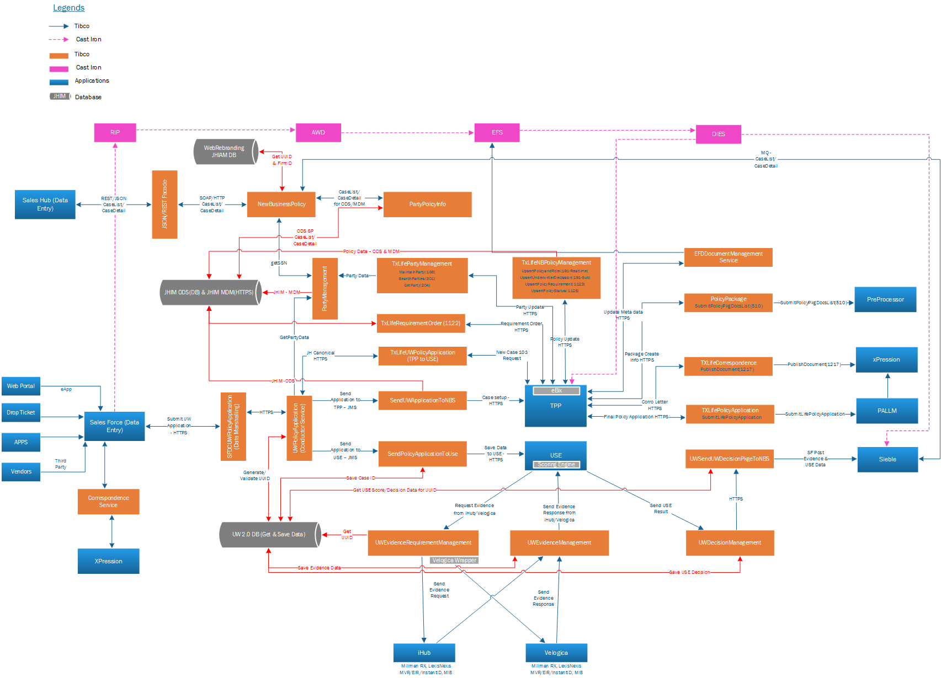
Representative set of services

Slide 8
Design Challenges to be solved
Design & Build
Cloud Native Architecture with API & Microservices
How target architecture will shape with API and microservices?
What are the typical solution tenants of to-be architecture?
Channel specific API access
How to process channel specific data formats in a seamless manner for applications like TPP & Sales Force?
Process Orchestration
How a end-to-end process flow (Saga) can be managed with microservices?
Data access layer/ Caching Layer
How microservices will persist & cache transaction data to enhance non-functional requirements(NFR) like user response?
Backend integration approach
How to manage integration logic like data transformation, routing, enrichment?
How to achieve configuration driven approach to manage integration logic?
Security ( Authentication & Authorization )
How API & microservices will ensure authentication & authorization of enterprise data?
How different facets of security like transport security, message security, data-at-rest security be achieved?
CI/CD pipeline
How to manage CI/CD pipeline with PCF tool?
Runtime Management
Containerization of microservices
How to containerize microservices on PCF?
Elastic scale up and down of microservices
How to configure and manage service scalability?
Service Discovery
How to manage naming services for containerize microservices?
Externalize service Configuration
How to externalize service configuration data?
How to manage those data across environments?
How to refresh configuration data at runtime?
Service Resiliency
How to provide resiliency in dealing with cascading service failure?
How to manage then centrally?
Aggregated logging & monitoring
How logging from microservices can be aggregated?
How to integrate with external log analytics platform like Sumologic from PCF?
Service monitoring
How to monitor service containers?
Service deployment
How to deploy service in zero deployment mode?
A
H
I
B
J
C
K
D
L
E
M
F
N
O
G
Notes:
RabbitMQ for Messaging layer
Caching Layer Redis from Microsoft
Service Discovery from PCF or Apigee
CI/CD pipeline – Concourse
Security – APIGEE ( suggestion or PCF )
-----------------
Architecture Pattern for inter service communication
Integration with Log aggregator with Splunk/ELK
Continuous Deployment Process

Slide 9
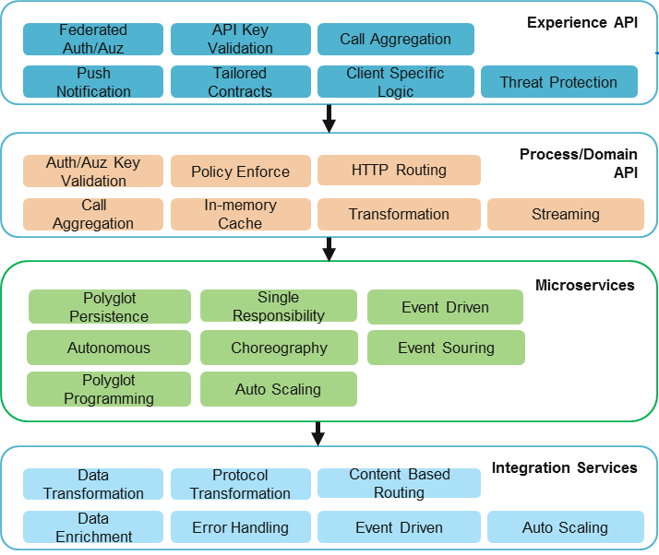
Cloud Native Architecture Building Blocks (ABB) & Design Principles
A
Cognizant’s proposed solution is guided by following core principles which align with John Hancock’s program objectives
Design First approach
Domain Driven Design principles to decompose core business functions
Swagger based API specification and Interface contract models
Multilayer decoupled Architecture
Microservices Architecture
Event choreography and orchestration to be on Microservices layer
Microservice layer to use event sourcing and Command Query Responsibility (CQRS) pattern
Mash-up Fine Grained APIs with simple routing and orchestration on API Layer
Use Data Virtualization and in memory caching
REST and event driven pub-sub integration among services
Loosely coupled with domain microservices via event exchange, sometimes using REST
Leverage message driven integration with system of record applications for asynchronous as well as pseudo-synchronous interactions
Decomposition by business capability
Data-centric, Experience and Business APIs
Lightweight messaging
Stateless / asynchronous
Leverage caching
DevOps friendly
Service discovery / Catalogs
Elastic scaling
Audit, log and monitoring
Right mix of fault handling / tolerance capability
Throughput management
Accelerators
Elastic Scalability
Individually deployable service packages for Business capability groups
Containerized Microservices can be designed to elastically scale up and down for effective infrastructure usage
Cloud Native Platform
Leverage PCF Spring features like Service discovery, Config service and Circuit breaker
Leverage CI/CD, Service Health Monitoring, Log visualization, Service Traceability and Application Performance Monitoring
API Management
Expose service functionalities as domain API
Take care of security concerns like authentication & authorization with current IAM
Create experience API per channel access to take care of specific security and NFR
Provide data aggregation at domain API level to provide enriched edge functionalities
System Of Records

Slide 10
To-Be Architecture with API-Microservices
A
Application Service | Technology/Tool
API Gateway | Apigee
API Management | Apigee
Cloud Native Platform | Pivotal Cloud Foundry
Microservice Framework | Spring Boot & Spring Cloud
Service DB | MySQL/Mongo – Persistence Store Redis – Name/Value Cache
Event Bus | RabbitMQ
Integration Service FW | Apache CAMEL
Log Aggregator | Sumologic PCF Nozzle for Sumologic
Security Service | UAM (existing)
PCF Platform Service | Discovery Service (Eureka) Config Service Circuit Breaker Service (Hystrix) PCF Metric PCF Auto-scale PCF Routing
Non Functional Service | Zipkin for tracing
Notes:
Sumo Logic is the log aggregator
PCF App Metrics - New Relic
Instead of SAGA pattern we can go with Event Sourcing
Spring Integration instead of Apache Camel

Slide 11
Solution Tenants of To-Be Architecture
A
Typical Solution Tenants for MSA
Domain Driven Design (DDD) model driven
Aggregate, Persistence & Domain Event
Segregate query and command handling
Event Sourcing & CQRS
Event driven pub-sub integration among services
REST principles like HATEOAS to expose microservice end points as domain API
Event choreography pattern
No central orchestrator
Easy to manage
Higher flexibility
Require orchestrator resiliency
Higher development cost
Event orchestration pattern
Simple to develop
Difficult to manage
Low flexibility
Microservice Architecture
Inter-service Communication
Principles & Standards
DDD principles
REST principles
EDA / CEP
Eventual Consistency
12-factor App
oAuth2
Expose service functionalities as domain API
Take care of security concerns like authentication & authorization with current UAM
Create experience API per channel access to take care of specific security and NFR
Provide data aggregation at domain API level to provide enriched edge functionalities
API
Architecture
Integration
Architecture
Loosely coupled with domain microservices via event exchange, sometimes using REST
Perform integration responsibilities like data enrichment, data transformation, protocol transformation and routing
Leverage message driven integration
Use DSL based Spring Integration or Camel framework for integration logic externalization
Microservice Technology
Cloud Native Platform - Runtime
Spring Boot & Spring Cloud
Axon framework for Command Query Responsibility (CQRS) & Event Sourcing
MySQL, Mongo & Redis for datastore
RabbitMQ / Kafka for event bus
ELK for log aggregation
Zinpin for tracing
Cloud Native Platform - Support
Use PCF(BOSC controller) to manage DB and event bus as managed service
PCF service
Discovery service
Configuration service that use Git base registry
Hystrix based Circuit Breaker service
Pivotal Container Service (PKS)
PCF Auto-scale service
11
CI/CD - Concurse , PCF natively supported tool
PCF Matric for monitoring
Circuit Breaker dashboard for service status
Log visualization – Kibana dashboard for consolidated log view
Service Traceability – end to end tracing visualization using Zipkin dashboard
Application Performance Monitoring – AppDynamics or New Relic tool dashboard
PCF is considered as PAAS

Slide 12
Channel Specific API Access Strategy
B
How to process channel specific data formats in a seamless manner for applications like TPP & SalesForce?
Context
Challenge
Solution
Create domain API for UW, new application, policy and party management that connect respective microservices and consume JH specific data format
Create experience API for TPP that consume ACORD data format and translate it to JH specific format before calling domain API(s)
Rationale
Separation of concern – Experience API manage client specific concerns like ACORD data model processing, decouple from domain API and microservices that deal with JH specific data model
TPP use ACORD data standard for UW, new application, policy management & party management transactions
Microservices for UW, New Application, Policy, Party Management expose functionalities via REST endpoints that use microservice specific JH data format
Sales Force use its own data format while pushing new application data

Slide 13
Process Orchestration Approach
C
How a end-to-end process flow (Saga) can be managed with microservices?
Context
Microservices for UW, New Application, Policy, Party Management expose functionalities via REST endpoints that use microservice specific JH data format
Solution
Adapt a command and event handling paradigm, commands are for processing transactions and events are generated post processing
Rationale
Logic of the saga is centralized and so it is easy to understand, clear separation of concern
Microservices also emit and consume events or light-weight messages over event bus (RabbitMQ here)
Create one dedicated orchestrator, holding central logic of orchestration across multiple microservices
Orchestrator consume domain events emitted from microservices post transaction and send commands to next services
Simplifies the participants interaction
Only one service to achieve resilience
Eliminates cyclic design-time dependencies. The orchestrator depends on the participants but not vice versa
Challenge
Business process like Under Writing flow has multiple business interactions with applications like TPP, SF, eApps, USE etc. How to work with microservices to realize these kinds of flows?

Slide 14
Process Orchestration, UW Flow Realization
C
Salient Points
Each external and internal applications call experience API for transactions
Experience API transforms data and call corresponding reusable Domain API
Application MS manage state change info of application in a service datastore (using MongoDB)
A dedicated UW Saga service manage all the required orchestrations
Saga service subscribes for application state change events to fire commands for other microservices
Saga service dehydrates state of process flow in its own DB (not shown in diagram for brevity)
Application domain service emits events after application state change
Integration services take care of data transformation of destination application
Event driven communications are done via RabbitMQ topic

Slide 15
Service Data Persistence & Caching Approach
C
How microservices will persist & cache transaction data to enhance non-functional requirements(NFR) like user response?
Context
Microservices for UW, New Application, Policy, Party Management expose functionalities via REST endpoints that use microservice specific JH data format
Solution
Microservice will manage its own business entity state machine like Application entity or Policy or Party entity
Rationale
As per 12-factor app principle, service should make use of datastore to manage it state
Microservices can store use MySQL & Mongo DB for persistence and Redis for cache
Challenge
Microservices being stateless does not store any state but business entities are generally state-full. How microservice make use of state-full entities?
Service data store will be transactional in nature be it relational or noSQL based
In case only caching of data are required, service will use name-value based data store Redis
There will be no distributed transaction over services
Data will be not be part of service as services are containerized stateless components

Slide 16
Backend Application Integration Approach
E
Microservices being more domain centric component, how the back end integration to both internal and external apps can be managed in a cloud native solution?
Context
Microservices for UW, New Application, Policy, Party Management expose functionalities via REST endpoints that use microservice specific JH data format
Solution
Use event based choreography between microservice and integration service
Rationale
CAMEL supports a rich DSL (Domain Specific Language) for externalize integration logic
Microservice architecture prefers event based loose coupling among services
Challenge
How to manage integration logic like data transformation, routing, enrichment?
How to achieve configuration driven approach to manage integration logic?
Create a separate layer of services for outbound integrations from microservices. For any inbound integration, use API layer to invoke microservices
For event based orchestration use dedicated Saga service to call integration services via commands
Integration services should leverage CAMEL framework on top of Spring Boot
Apache CAMEL externalize all established EIP patterns via routes; also provides a tons of standard integration adapters
Spring Boot has excellent support for CAMEL, support both XML and Java based route definitions
Integration service should make use of specific framework

Slide 17
Runtime Management of Microservices
H
I
J
K
L
M
N
O
Containerization of microservices
Use PCF Elastic Runtime to run Spring Boot Application. Later PKS can be leveraged also
Service Discovery
Use PCF Discovery service to register & bind containerized microservices
Log aggregation
Use PCF Metric to aggregate log from services. Configure PCF Nozzle to push log to Sumologic analytics platform
Service Resiliency
Use Hystrix based PCF Circuit Breaker to identify & isolate failed instances & prevent cascading failure
Manage elastic load
Use auto-scale features of PCF, manage scaling with configuration rules
Service Configuration
Use PCF Configuration service to manage environment specific service configuration
Service Monitoring
Use Spring Actuator to collect service matrix and visualization
For advanced feature use New Relic or AppDynamics, configured with PCF service broker
Zero down-time Service Deployment
Use PCF Blue Green deployment features to deploy zero shutdown service deployment
Notes:
How to containerize microservices on PCF?

Slide 18
Thank You

